Slide 1
Why People really love Technology
An interview with Genevieve Bell

Slide 2
Department of English P.R.Government College(A), Kakinada

Slide 3
Genevieve Bell

Slide 4
Where is technology heading?
The use of information and communication technologies has scaled out beyond the West pretty spectacularly. What—800 million cell phones in circulation in India; 750 million in China. The second biggest country for Face book is Indonesia. Clearly the most interesting stuff with technology in some ways isn’t even happening here anymore. In 1999, 70 percent of the world’s Internet users were based in North America. By 2009, it was less that 16 percent. That astonishing statistic sort of tells you the world has moved on its axis.

Slide 6
How does culture affect technology?
I’m an anthropologist so I look at culture and values and how technology is incorporated into that culture. For example one of the most popular websites in India is the matrimonial classified…getting a husband is a database problem. Mobile phones across the Middle East, North Africa and Islamic Southeast Asia are often used to find Mecca because your phone has GPS technology so that when you’re on the road you can pray five times a day.

Slide 8
Which products do you use?
I’m on my second generation of Kindles. I’m a woman who loves books, too. If you were to pry the Kindle out of my hand, you would discover it’s full of the trash that I would once have bought in airports to read on airplanes. It’s become my trashy book file. I also have a digital single-lens reflex camera. A Blackberry which lets me have a 15-hour-a-day conversation with my best mate in Australia. A laptop, a ThinkPad. A Bluetooth headset. An iPod.

Slide 9
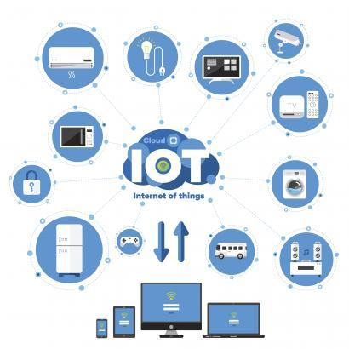
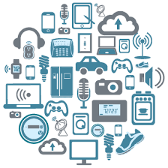

Slide 10
Any huge dangers on the horizon?
You know that technology is important at the point that people become convinced it’s going to destroy everything. Look at the introduction of electricity: one of the first things said in testimony before the Senate was that it would be the end of the American family. I’m like, “Really?” Radio was going to be really bad because we were going to stop talking to each other. Television was going to be really bad because it was going to atrophy our brains. Movies were going to destroy books. This kind of wonderful story gets mobilized about new technology and inevitably links it to the decline of everything we think we value. One of the challenges here is that all this [digital] technology is so new—less than ten years in common circulation for the Internet. And what a surprise—we don’t know the answers yet.

Slide 11
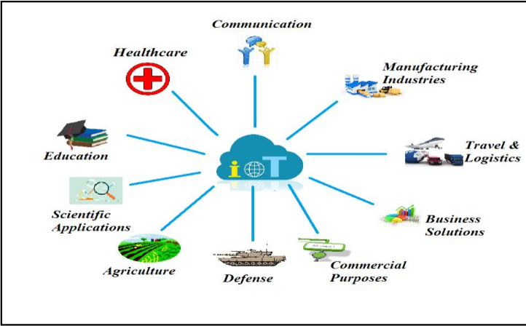

Slide 12
What about the role of women in technology?
Women are often early adopters of new technology. Women mastered the first round of what were in some ways intensely unreliable gadgets—refrigerators, washing machines, ovens. They became similar custodians of telephones and television. They led the way in driving mobile phones from road warriors into the general population. I am always interested about the way we tell the story that erases women’s technology prowess—in no small part because most of the technologies women mastered became invisible very quickly. They became appliances. We took away the sexiness of mastering them.

Slide 14
Why this rap that women are technologically-challenged?
Well I’d be tempted to say patriarchy. Of course, in reality it is more complicated than that. We don’t tell a lot of stories about women as technology masters despite the fact that they always have been. I think we need to get better at acknowledging our own expertise!

Slide 15
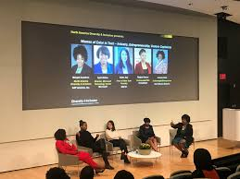

Slide 16
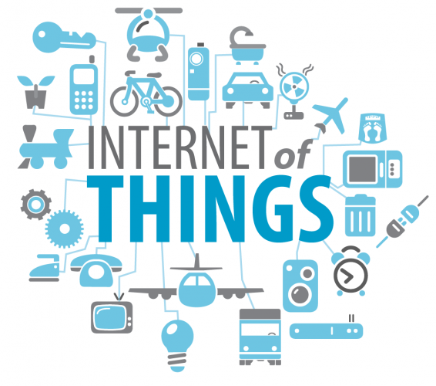
Thank you

